Slide 1
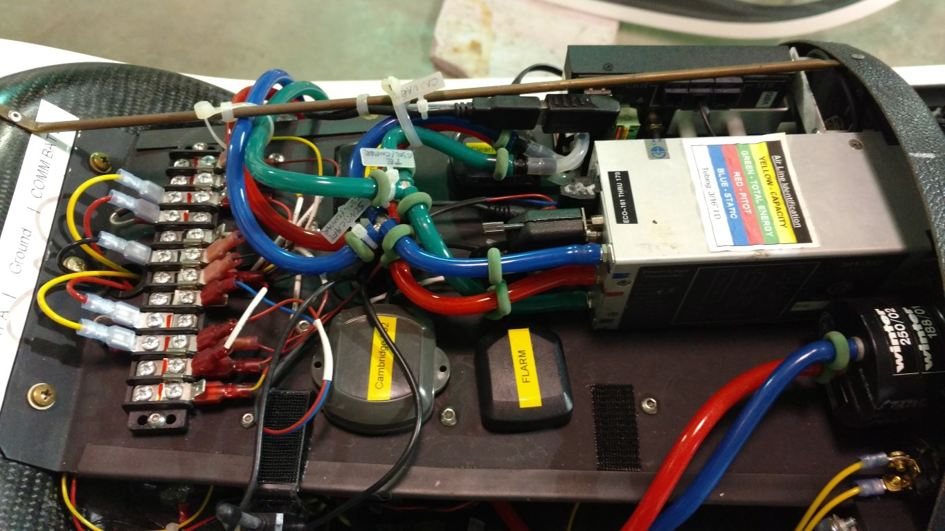
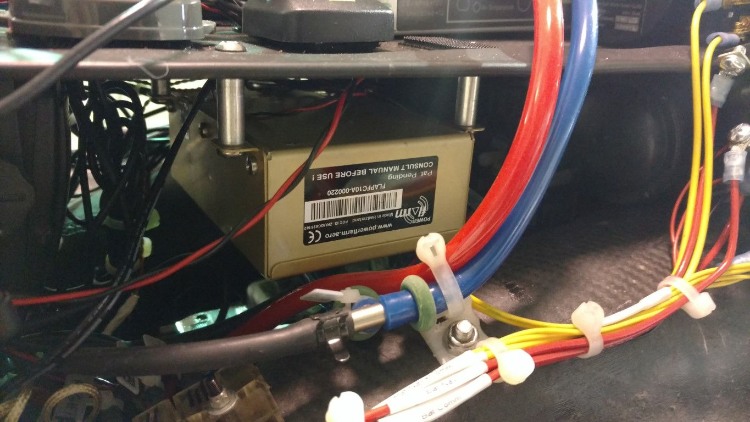
ASW-27 N227BB
Avionics – Shelf Views

Slide 2

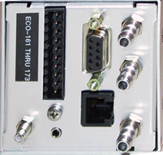
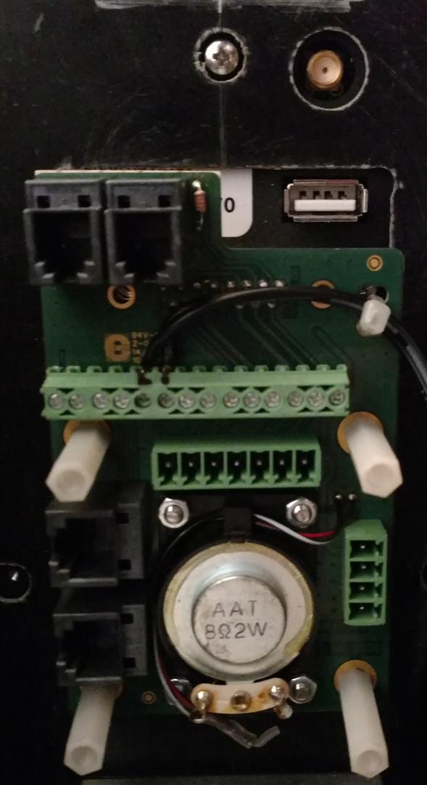
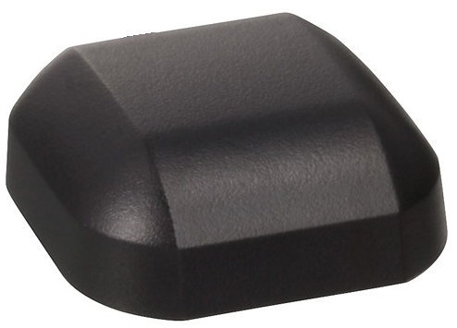
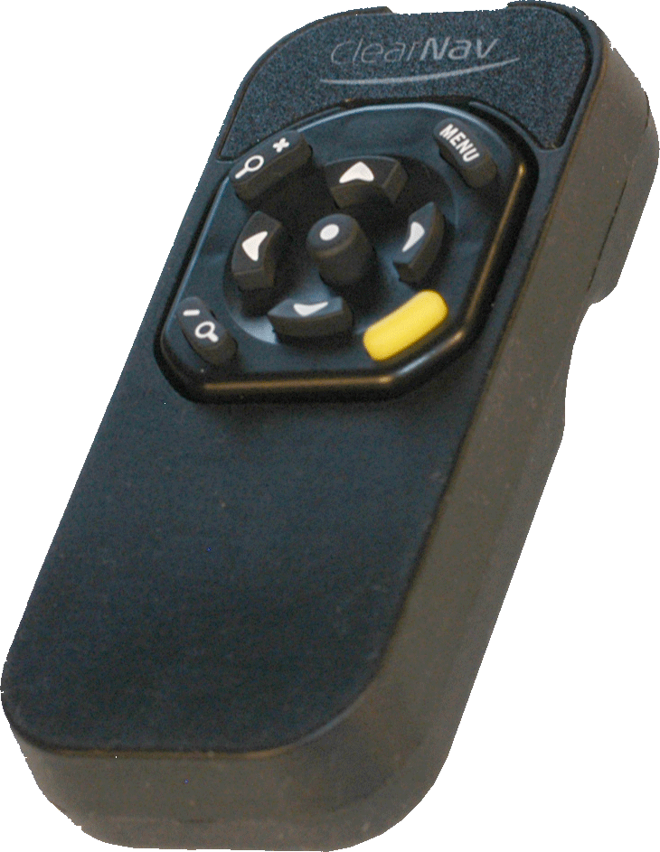
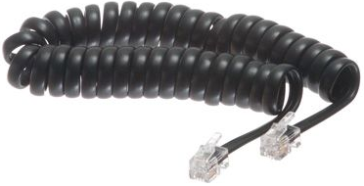
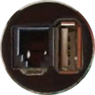
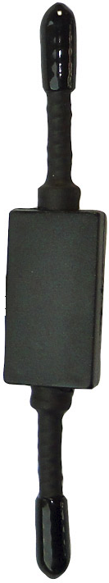
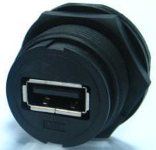
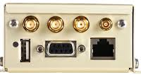
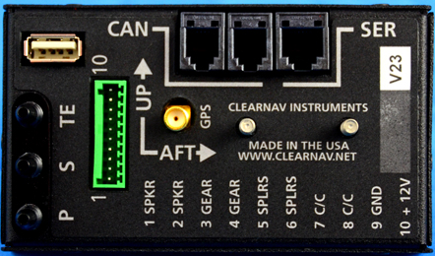
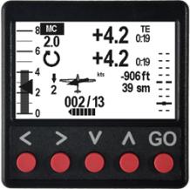
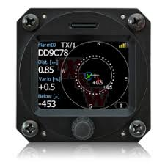
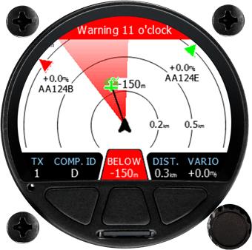
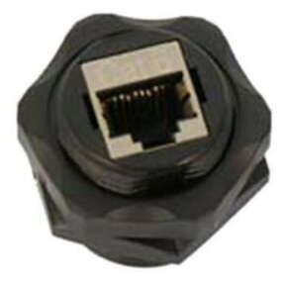
ASW-27B N227BB
Navigation Avionics - Functional Block
External
Speaker
(Pilot’s Left)
Cambridge 302
ClearNav Display Controller
Power
CN Controller
GPS
Antenna
GPS
Antenna
CN Panel Jack
On Instrument
Panel
OAT
Power
FLARM Core
USB Jack
(Under Instrument Panel
at right thigh)
FLARM A
Antenna
ADS-B
Antenna
GPS Antenna
CAN Bus Cable
Power
Speaker
Cruise/Climb (C/C) Switch
ClearNav Vario
GPS
Antenna
CAN
Power
N/C
ClearNav Vario ADC
USB Jack
(Under Instrument Panel
at right thigh)
RF-45 Jack
(Under Instrument Panel
at right thigh)
LXNav
TrafficView

Slide 3
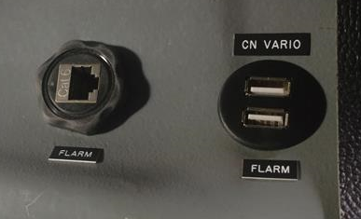
ASW-27B N227BB
Navigation Avionics – External Access Jacks
ClearNav Display Controller
CN Panel USB Jack
Located on the Instrument
Panel
ClearNav Vario ADC
USB Jacks
Located under the instrument panel at right thigh
Disconnected
FLARM Core

Slide 4

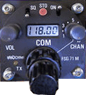
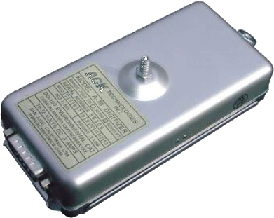
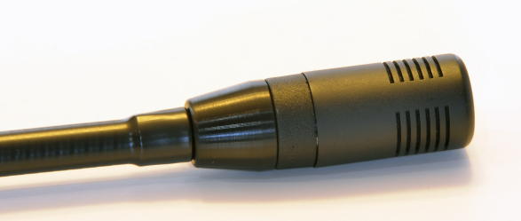
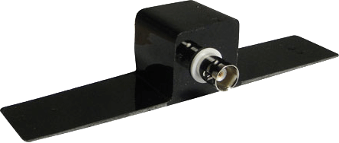

ASW-27B N227BB
Communication Avionics - Functional Block Diagram
Transponder
Becker ATC4401
Transceiver
Dittel FSG71M
1202
Transeiver
Power
Power
20 gauge
20 gauge
External
Speaker
(Pilot’s Right)
Antenna
ACK A-30
Altitude Encoder
Boom Microphone
F2 Antenna
(located in the top of the vertical stabilizer in the vacant battery box)
Push to Talk

Slide 5




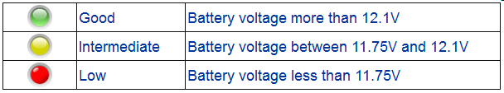
ASW-27B N227BB
Avionics - Power Distribution
To Navigation Avionics
Power Terminals
(CN, CNv, C302)
To All Avionics
Ground Terminals
To Communication Avionics
Power Terminals
(FLARM, Transceiver, Transponder)
Battery A Bus
Battery A/B Ground Bus
Battery B Bus
Schottky Diode (1N5821)
To Battery A
Ground
Connection
To Battery B
Ground
Connection
Schottky Diode (1N5821)
Battery Bus
Bridging
Switch*
GliderGuider
LED Battery
Monitor**
Master Breaker/Switch 5A
(TYCO W31)
Master Breaker/Switch 5A
(TYCO W31)
GliderGuider
LED Battery
Monitor**
Battery A
(Navigation)
Battery Negative Wiring
To Instrument Panel Ground Bus
Battery B
(Communications)
* The Battery Bus Bridging Switch is used to tie the two power buses together and, by using the two diodes, not allowing cross charging of the batteries
** GliderGuider items were available at http://gliderguider.net
** GliderGuider LED Battery Monitor (http://www.gliderguider.net)

Slide 6
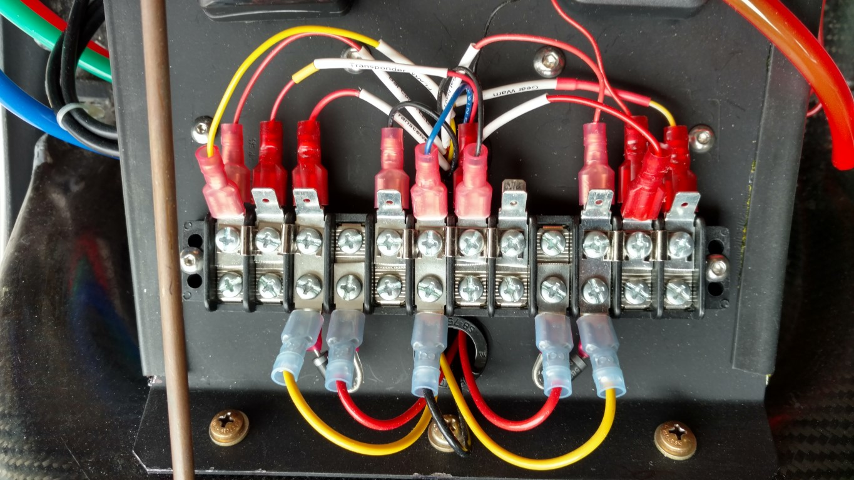
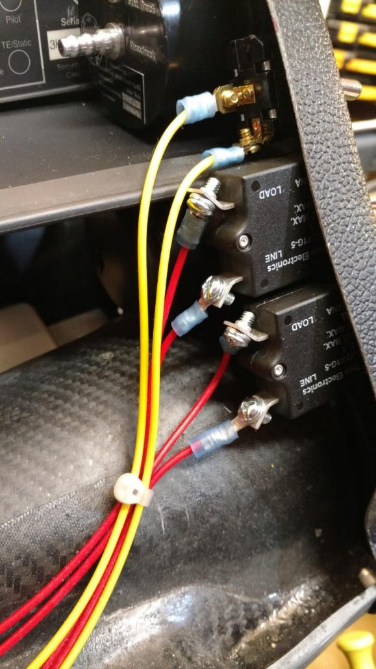
ASW-27B N227BB
Avionics Power Distribution
Positive Battery A Bus
Connections
Negative Battery Bus
& Ground Connections
Positive Battery B Bus
Connections
Battery A/B Buses
Bridging Switch
5A Breaker/Switch
“Navigation”
Battery A Bus
5A Breaker/Switch
“Communications”
Battery B Bus

