Slide 1

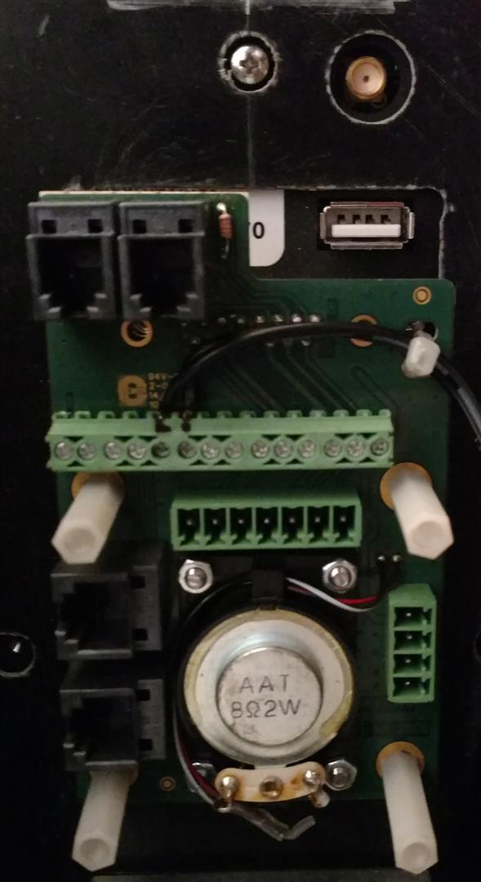
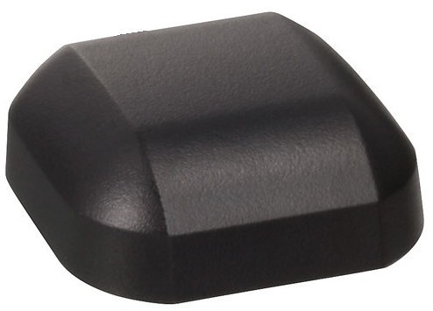

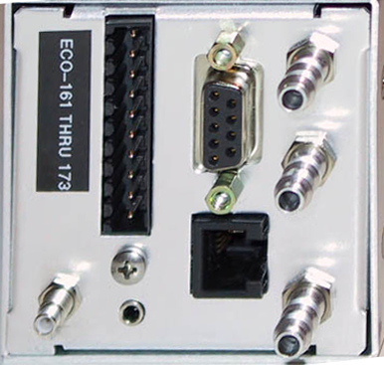

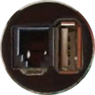
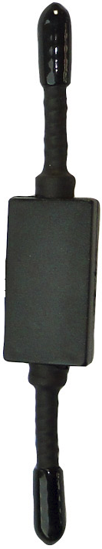
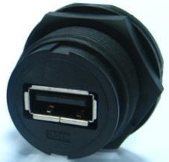
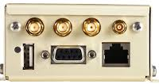
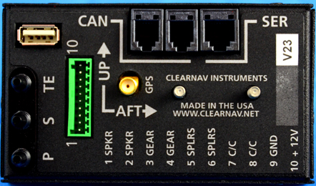
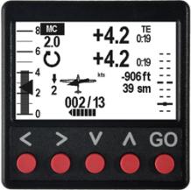

ASW-27 N227BB
Avionics Functional Block Diagram
External
Speaker
Cambridge 302
ClearNav Display
Power
CN Controller
GPS Antenna
CN Panel Jack
OAT
Power
GPS Antenna
FLARM Core
FLARM A
Antenna
ADS-B
Antenna
GPS Antenna
ClearNav Vario ADC
USB Panel Jack
External
Speaker
Power
GPS Antenna
ClearNav Vario
CAN
Power
USB Panel Jack
RJ45 Panel Jack
1/29/19 JHDeRosa

Slide 2
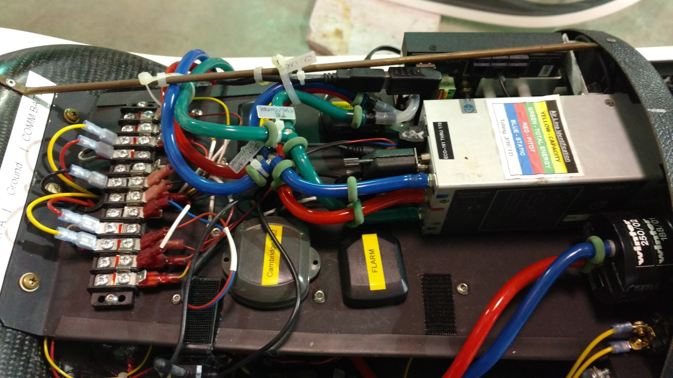
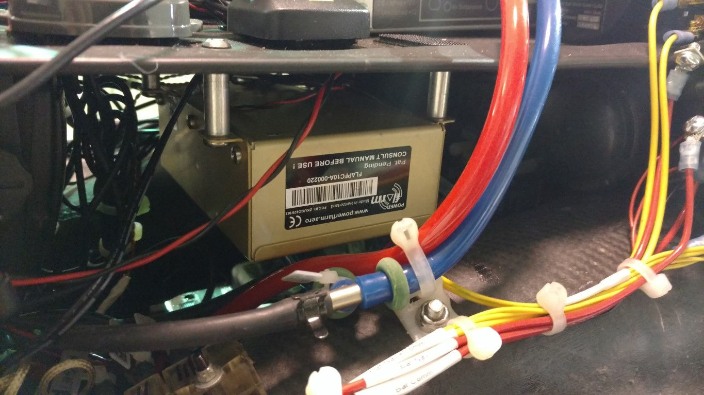
ASW-27 N227BB
Avionics Shelf
1/29/19 JHDeRosa

Slide 3




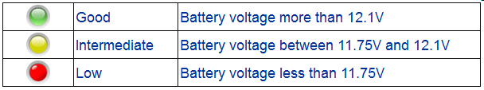
ASW-27 N227BB
Avionics Power Distribution
To Avionics
Battery A Bus
(Navigation)
Battery Ground
Bus
Battery B Bus
(Communications)
+
Schottky 1N5821 Diode
Schottky 1N5821 Diode
Battery Bus
Bridging
Switch*
Bat A Connected
+
Battery B
GliderGuider
LED Battery
Monitor**
Master Breaker/Switch 5A
(TYCO Model W31)
Master Breaker/Switch 5A
(TYCO Model W31)
GliderGuider
LED Battery
Monitor**
Bat B Connected
12Vdc
Battery A
(Navigation)
12Vdc
Battery B
(Communications)
** GliderGuider LED Battery Monitor (http://www.gliderguider.net)
* The Battery Bus Bridging Switch is used to tie the two power buses together and,
by using the two diodes, not allowing cross charging of the batteries
1/29/19 JHDeRosa

Slide 4
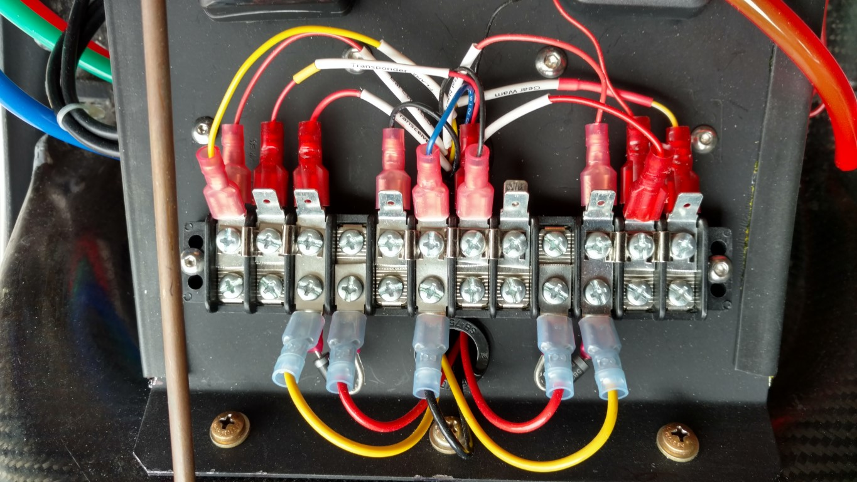
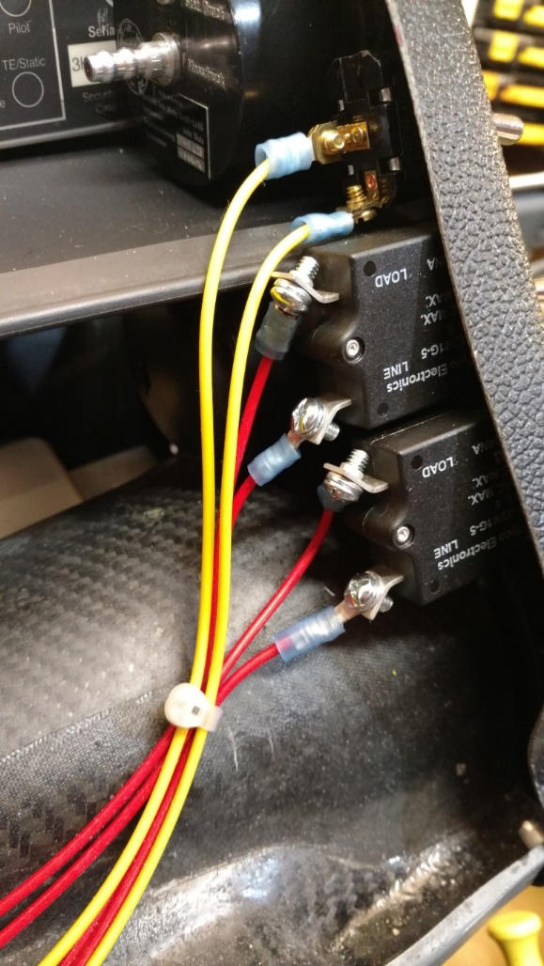
ASW-27 N227BB
Avionics Power Distribution
Positive Battery A
Connections
Negative Battery
& Ground Connections
Positive Battery B
Connections
Battery Bus
Bridging
Switch
Breaker Switch
Navigation Bus
Breaker Switch
Communications Bus
1/29/19 JHDeRosa

